Slide 1
SQL PROGRAMMING
& JDBC

Slide 2
CREATING
A DATABASE

Slide 3
Development Environment
These slides assume you have the following tools installed
MySQL Community Server
MySQL Workbench
IntelliJ Ultimate

Slide 4
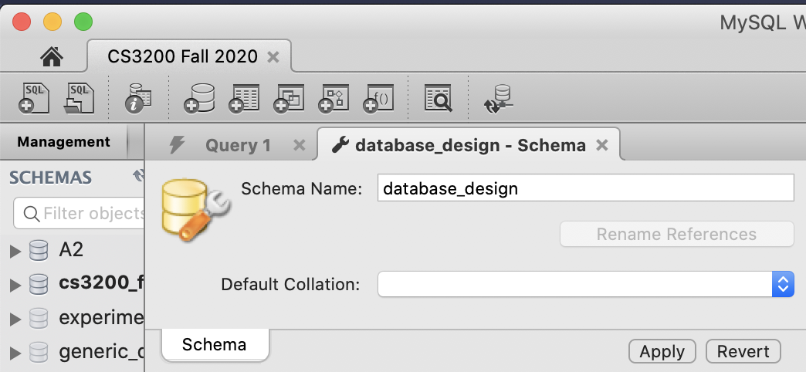
Create a Schema
If you don't already
have a schema,
create one with
MySQL Workbench

Slide 5
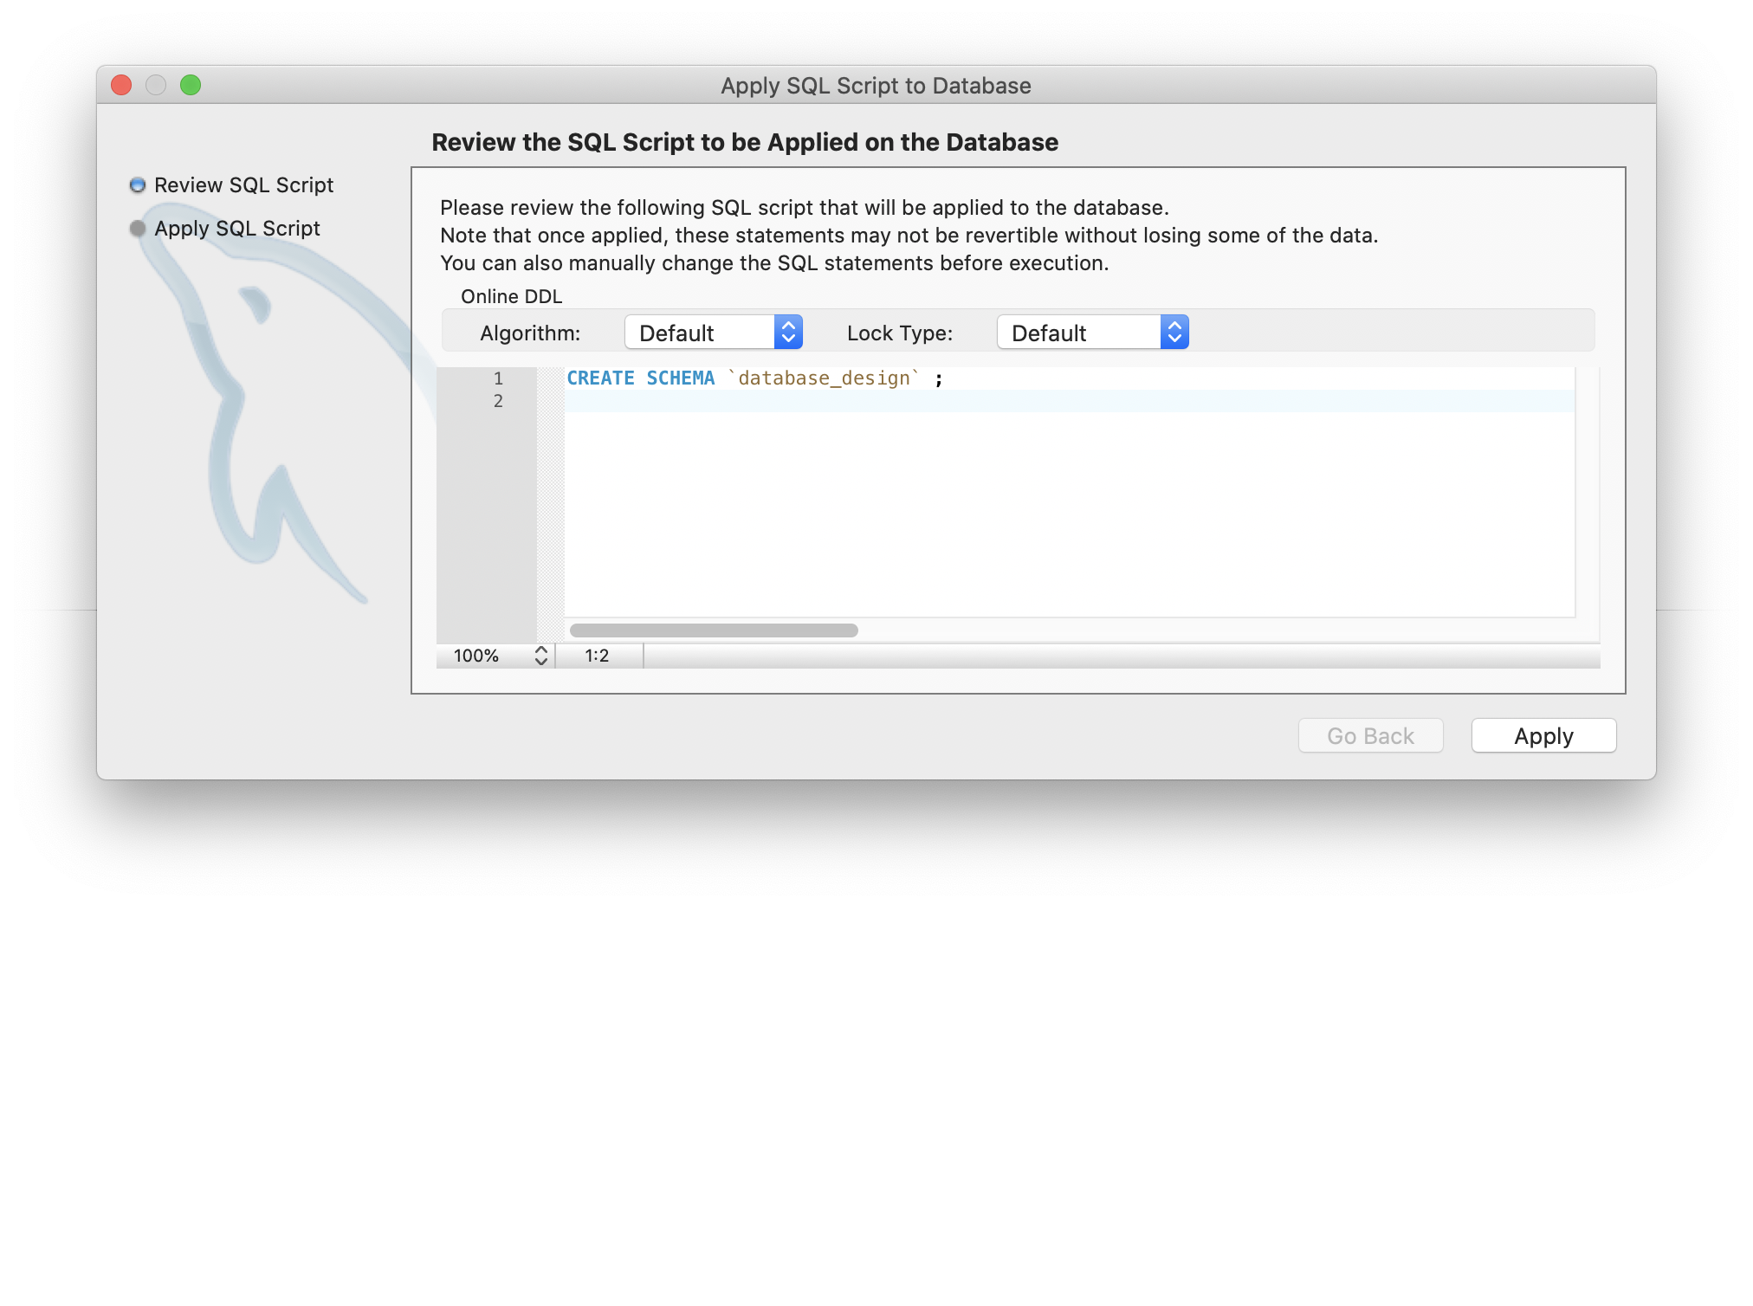
Apply Schema

Slide 6
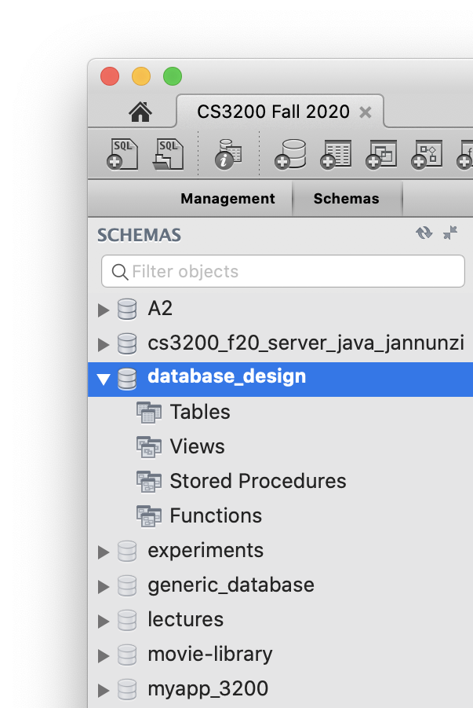
Select a schema as default
On the left hand side, under the Schemas tab, double click the schema you want to work with
This will now be your default schema when you issue SQL commands from now on

Slide 7
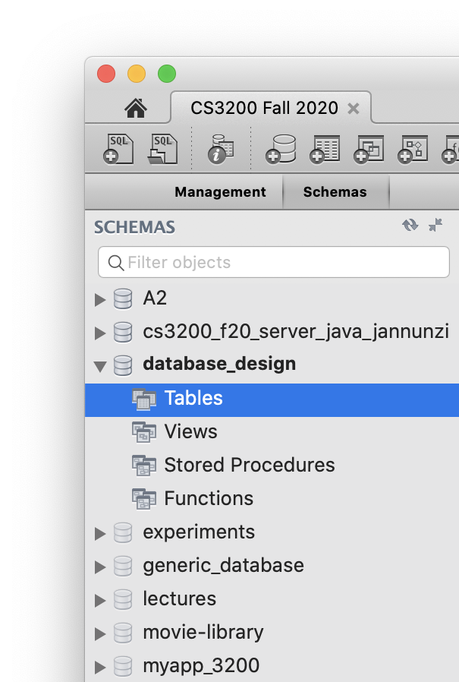
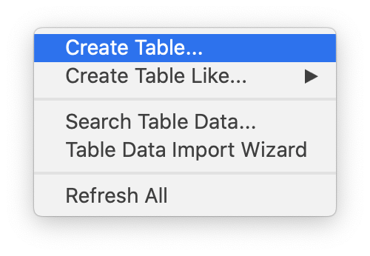
Create tables
You can create tables by either right clicking on Tables under your schema
OR clicking on the Add Table tool in the toolbar

Slide 8
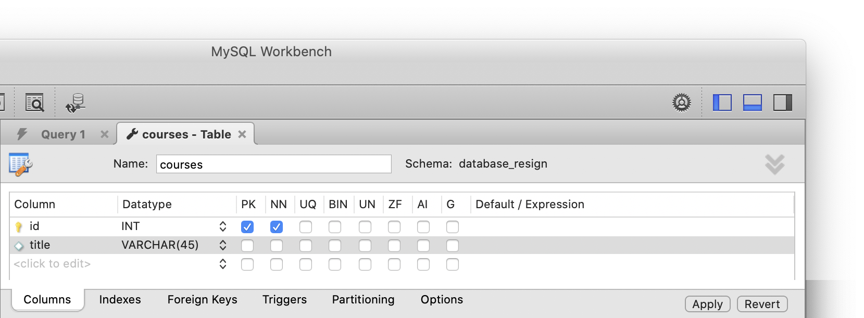
Create a courses table
Let's create a simple courses table to capture info about your courses
Table names should be nouns and plural

Slide 9
Review and Accept New Table
MySQL gives you a preview of the CREATE statement it'll use to create the table
You can review and then accept it by clicking Apply
CREATE TABLE `database_design`.`courses` (
`id` INT NOT NULL,
`title` VARCHAR(45) NULL,
PRIMARY KEY (`id`));

Slide 10
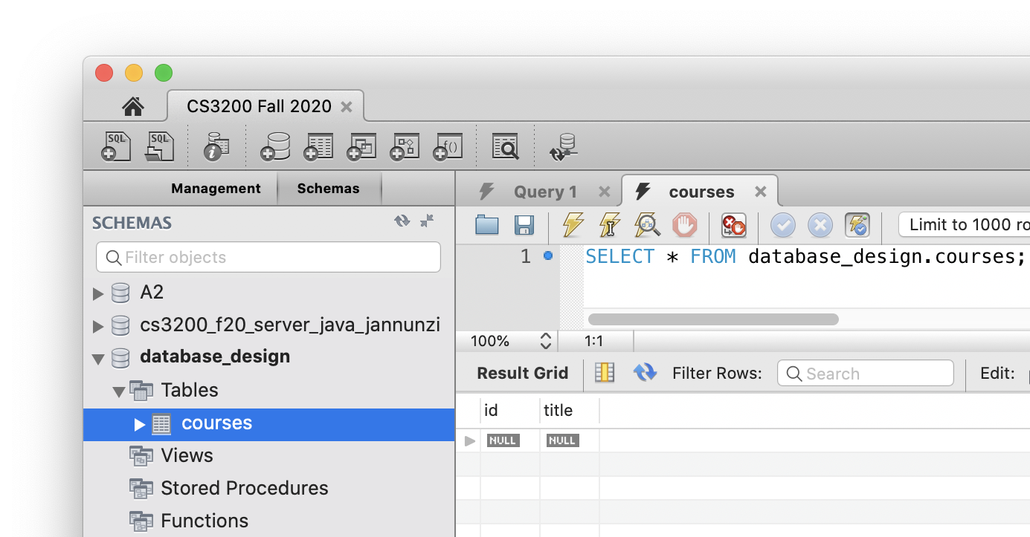
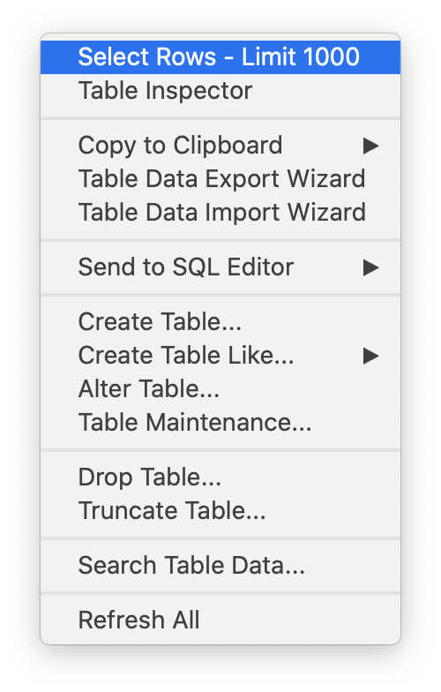
View Table's Data
You can view a table's data by right clicking the table and selecting: Select Rows - Limit 1000
The SELECT statement appears in a new SQL editor
Data appears in a Result Grid

Slide 11
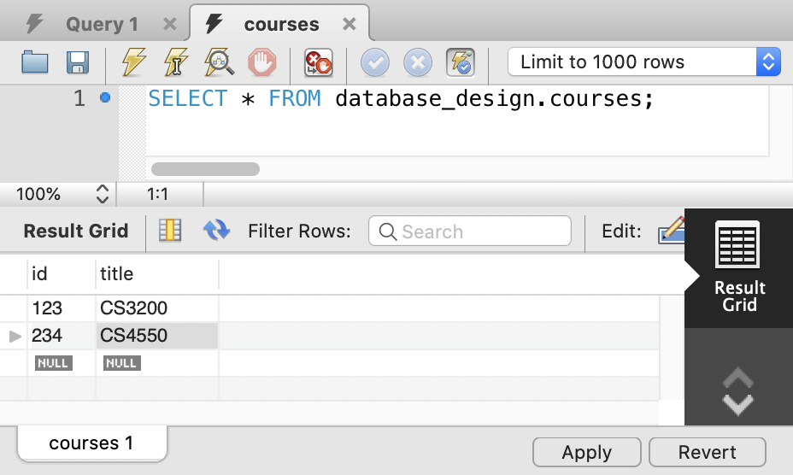
Inserting New Data in MySQL
To insert new data, you can type the INSERT statements in an SQL editor
OR you can also enter new data in a Result Grid
Press Enter key after every new data you enter
Press Apply when done

Slide 12
Review and Accept Insert Statements
MySQL gives you a preview of the INSERT statements it'll use to insert the data
Review and accept by pressing Apply
INSERT INTO `database_resign`.`courses` (`id`, `title`) VALUES ('123', 'CS3200');
INSERT INTO `database_resign`.`courses` (`id`, `title`) VALUES ('234', 'CS4550');

Slide 13
CREATING
A USER

Slide 14
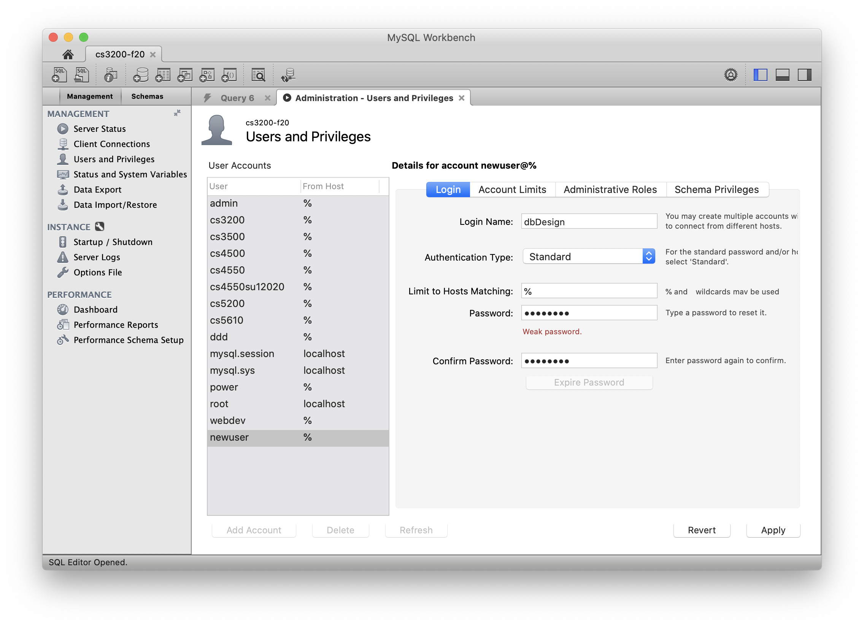
Create a User
Configure an account, e.g., username: dbDesign password: dbDesign
We'll use this account to connect from Java

Slide 15
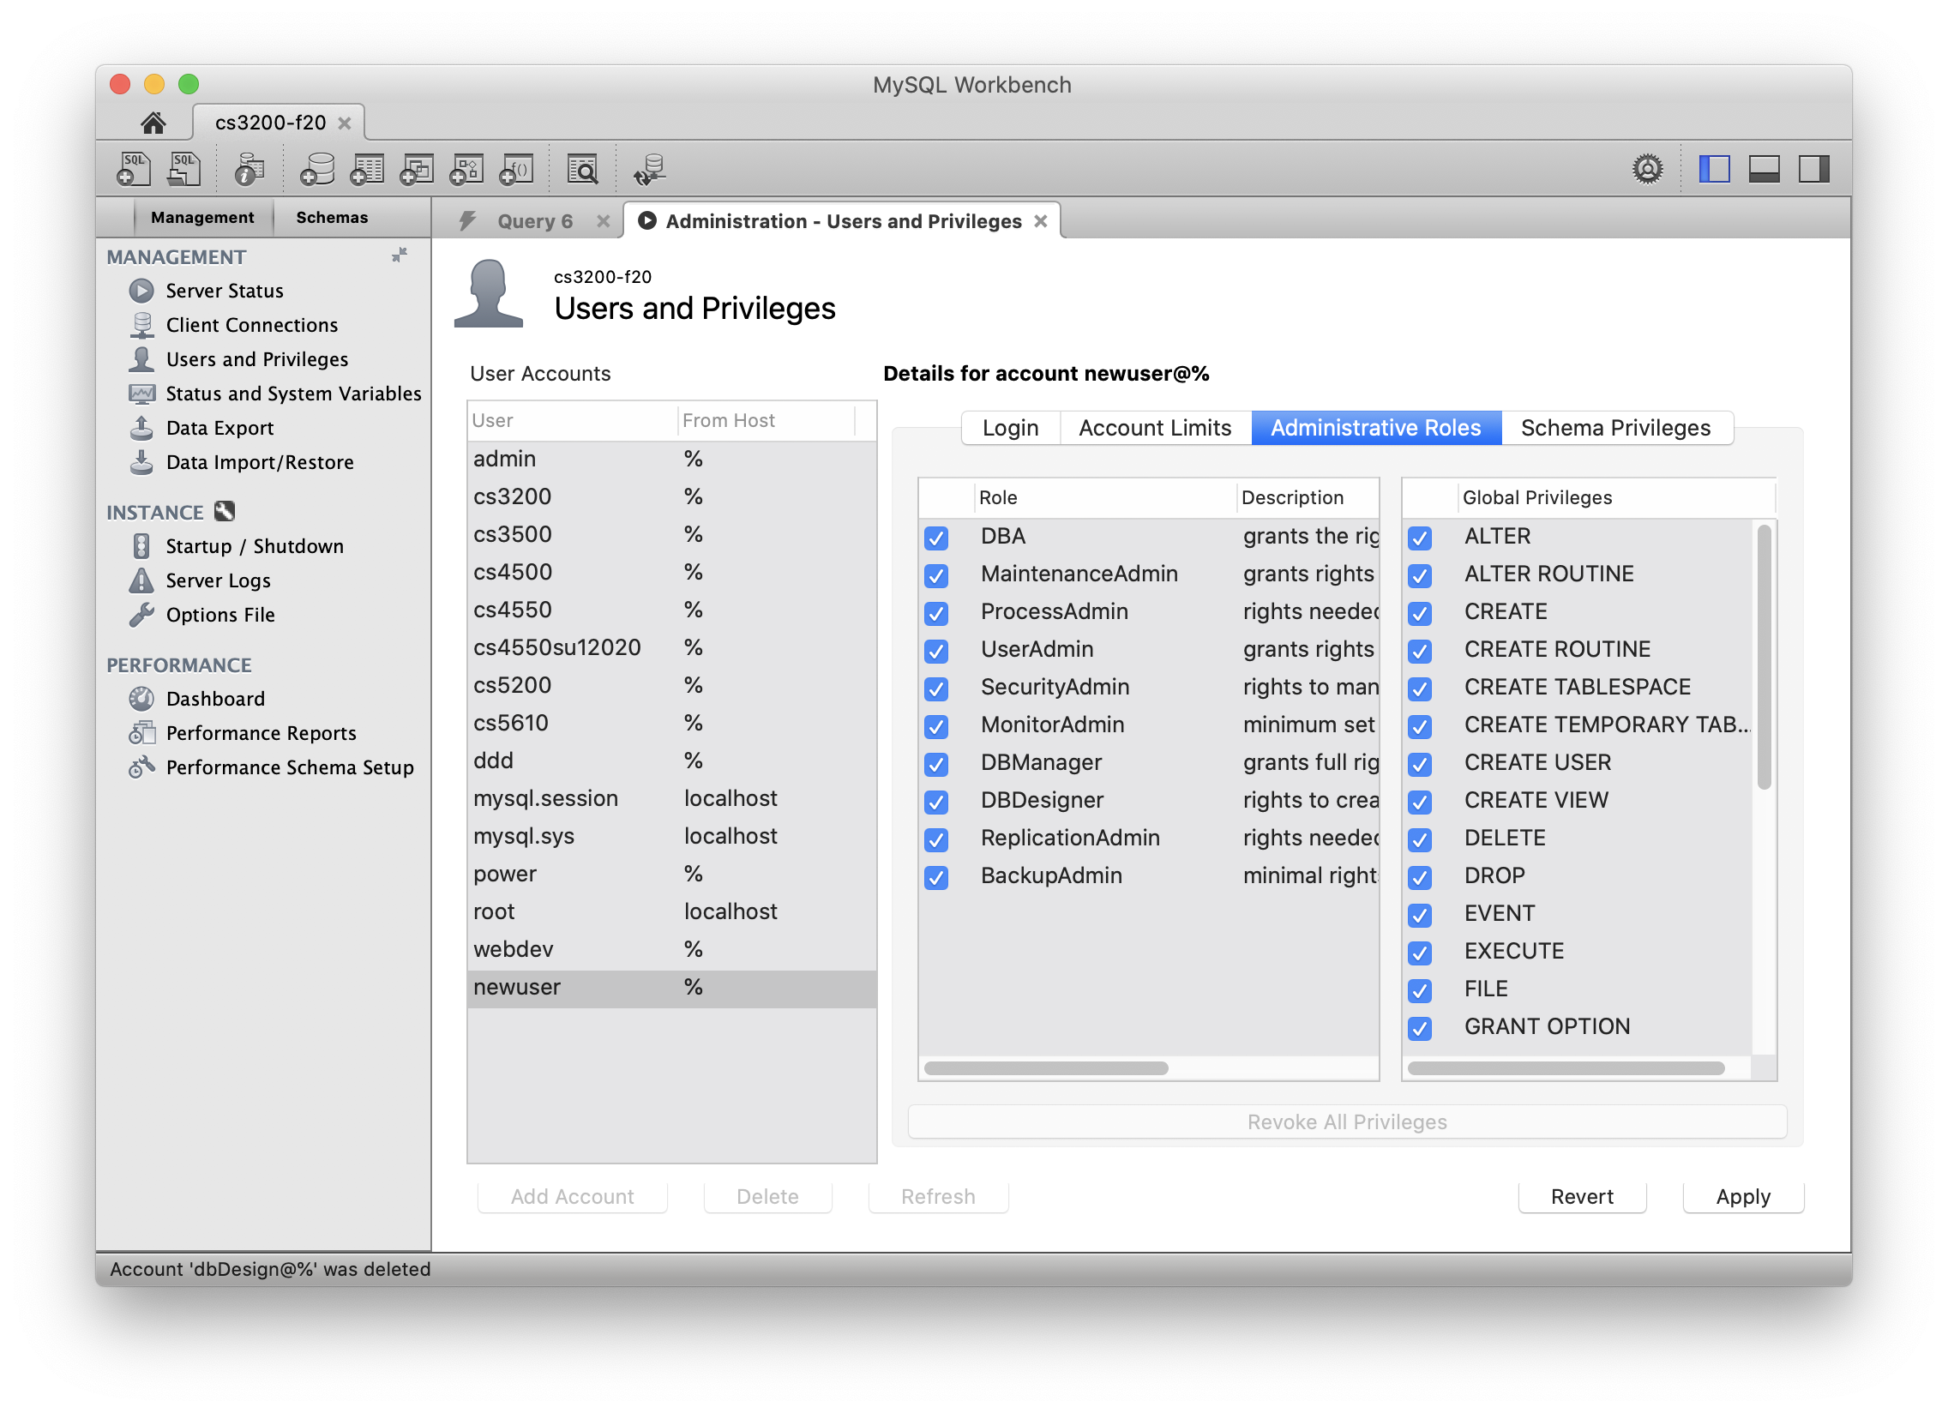
Make the user a DBA
Give the account all privileges making them a DBA
Database Administrator

Slide 16
CREATE JAVA PROJECT

Slide 17
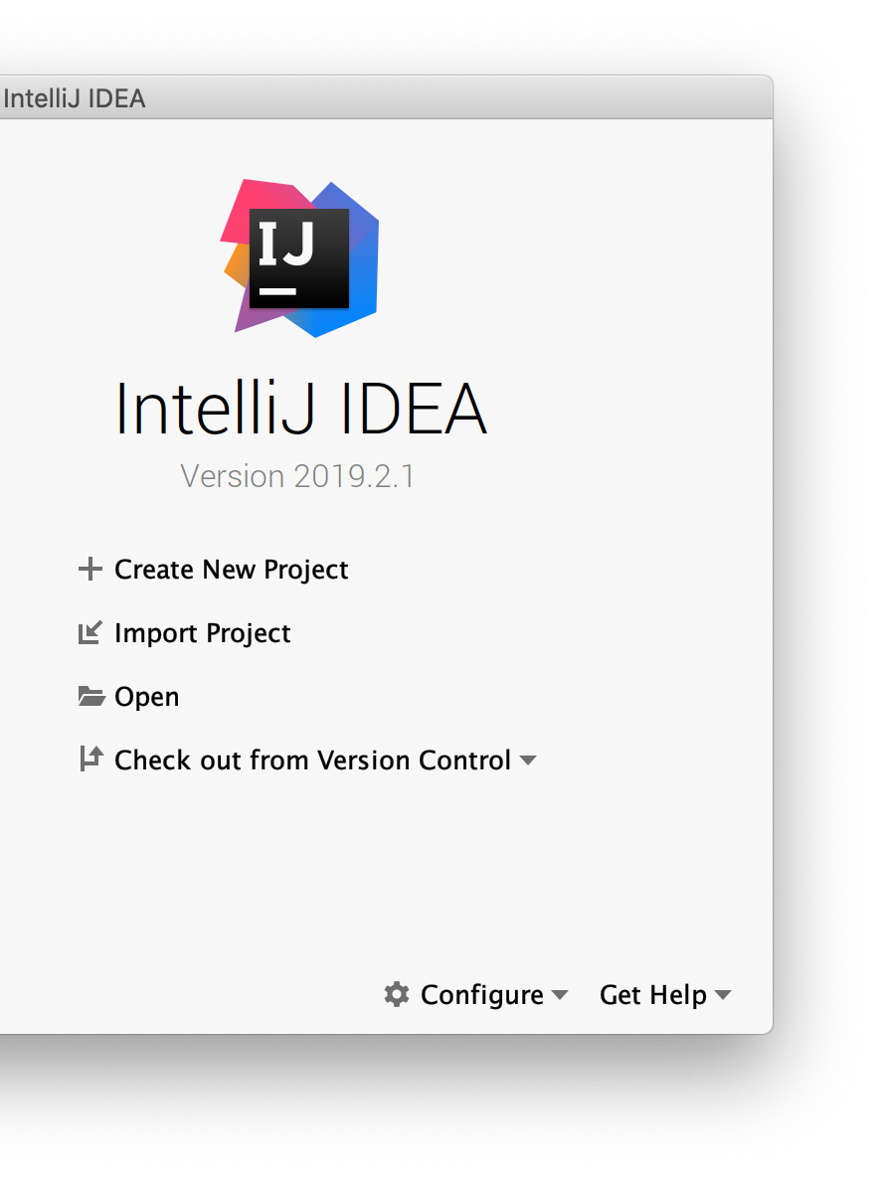
Create a New Java Project
Let's create a Java application that can connect to the database
Using IntelliJ, create a new Java project
We'll have to add MySQL libraries to connect to the MySQL database server

Slide 18
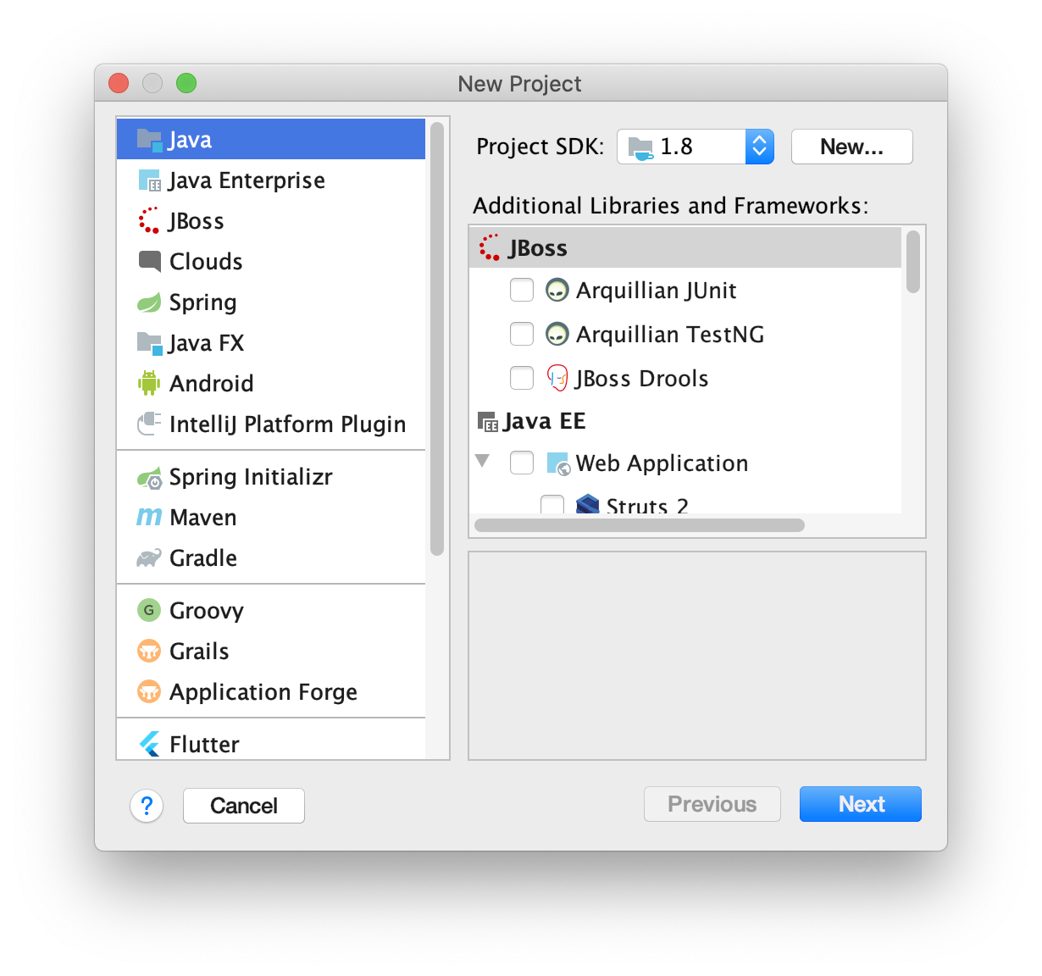
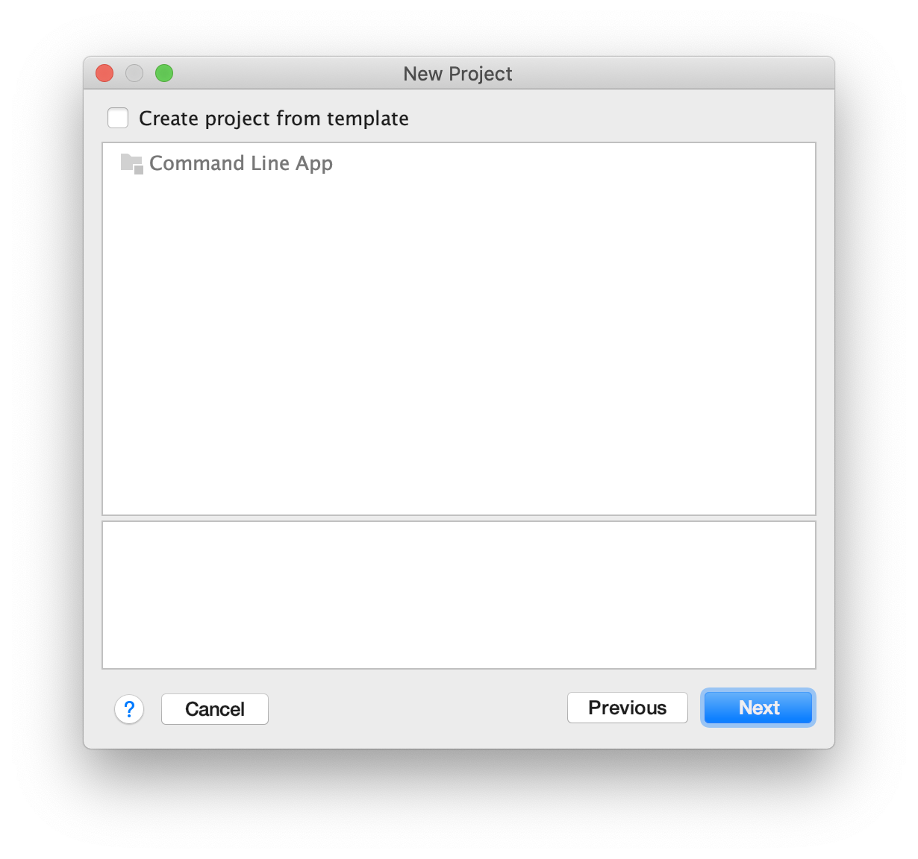
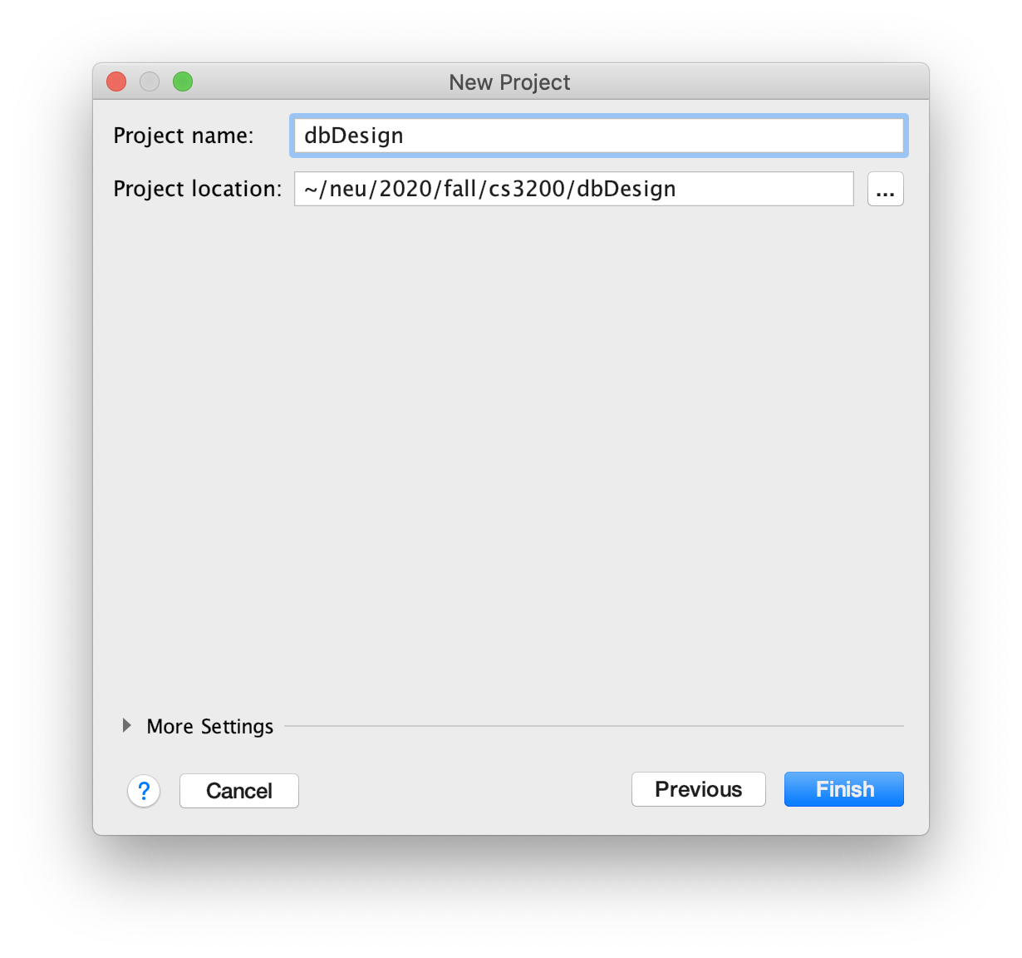
Create a New Java Project
Accept the defaults for the new Java project

Slide 19
CONFIGURING JDBC

Slide 20
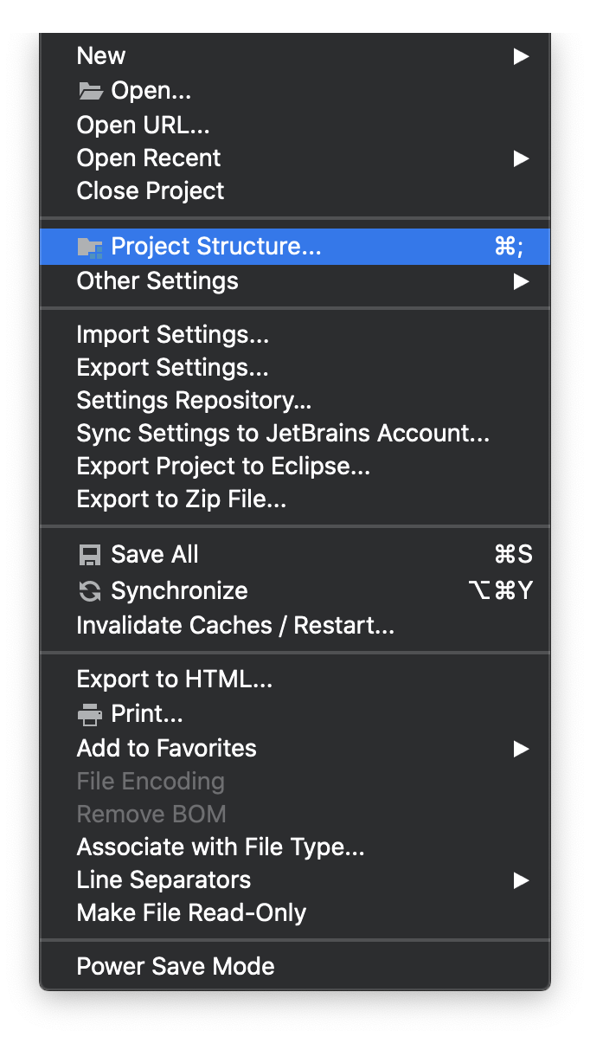
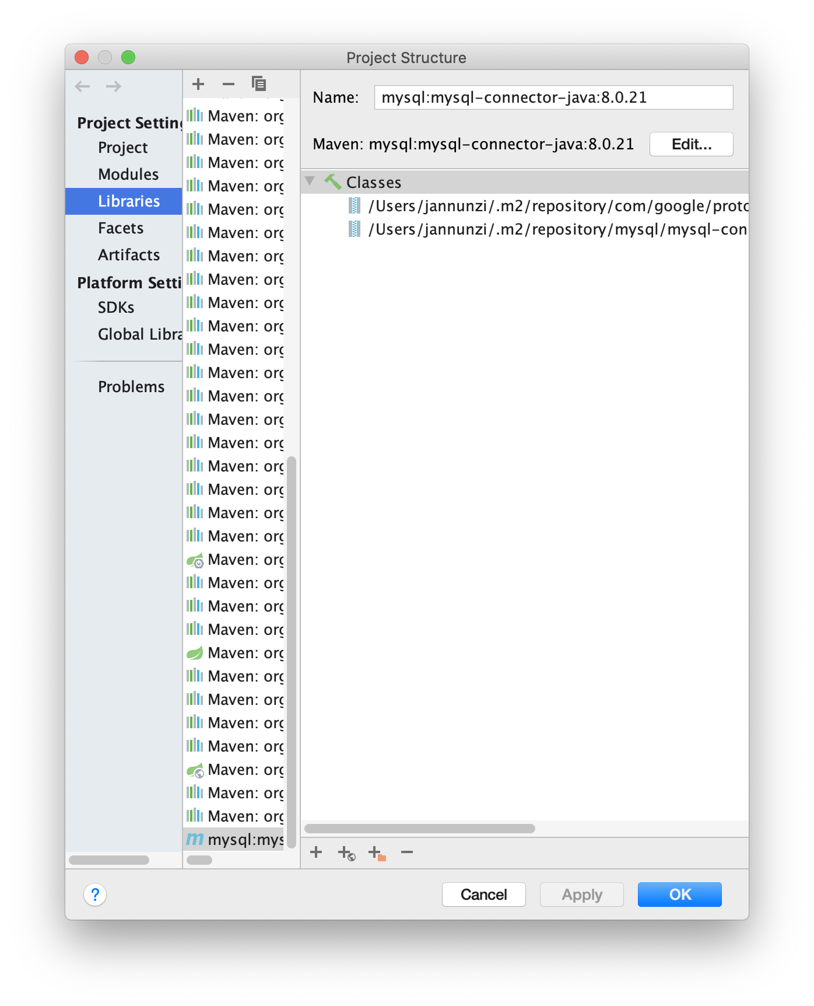
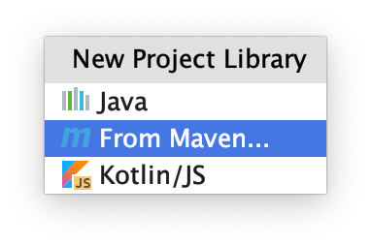
Add mysql-connector-java Library
Let's add MySQL connector library
From File menu, select Project Structure...
Then
Libraries
PLUS
From Maven

Slide 21
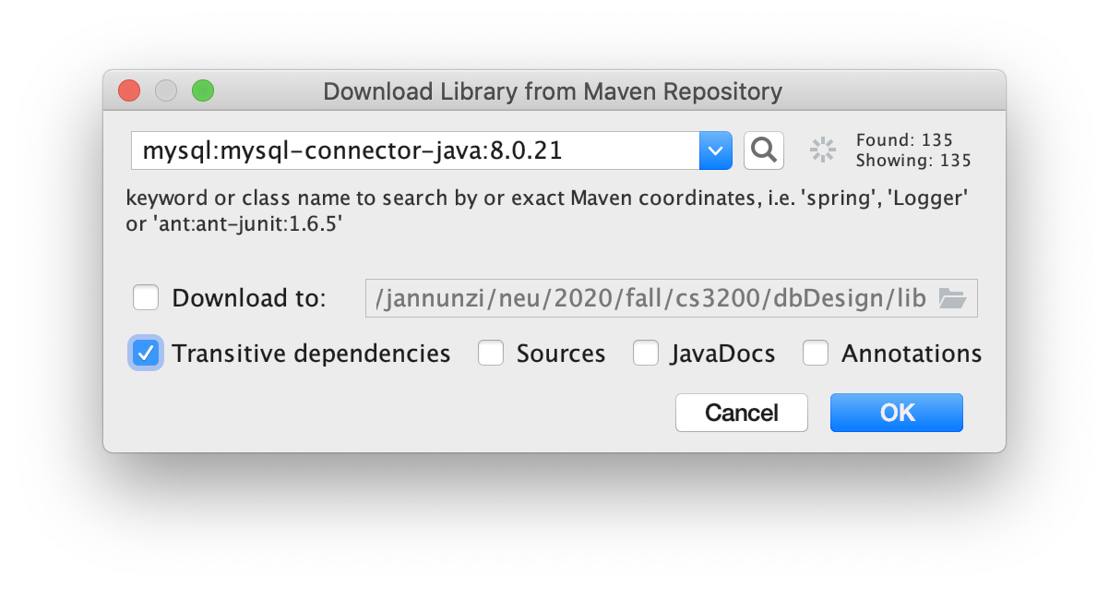
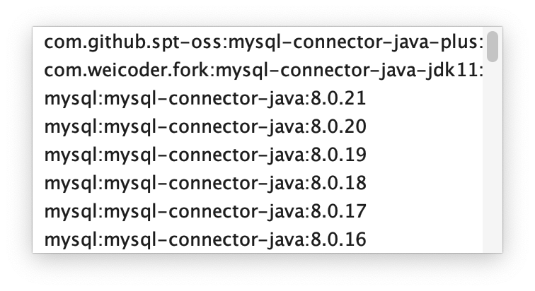
Search for MySQL's Java connector
Type the following and click on the search button:
mysql-connector-java

Slide 22
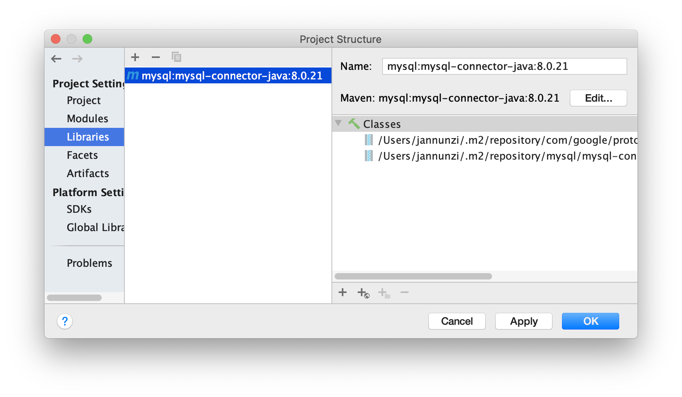
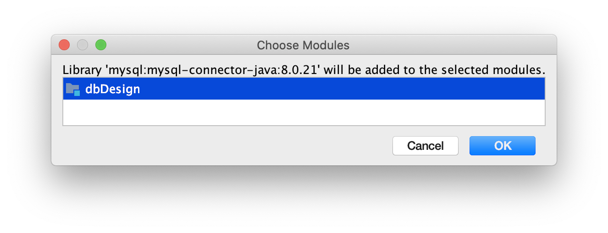
Add library to project
Add library to current project

Slide 23
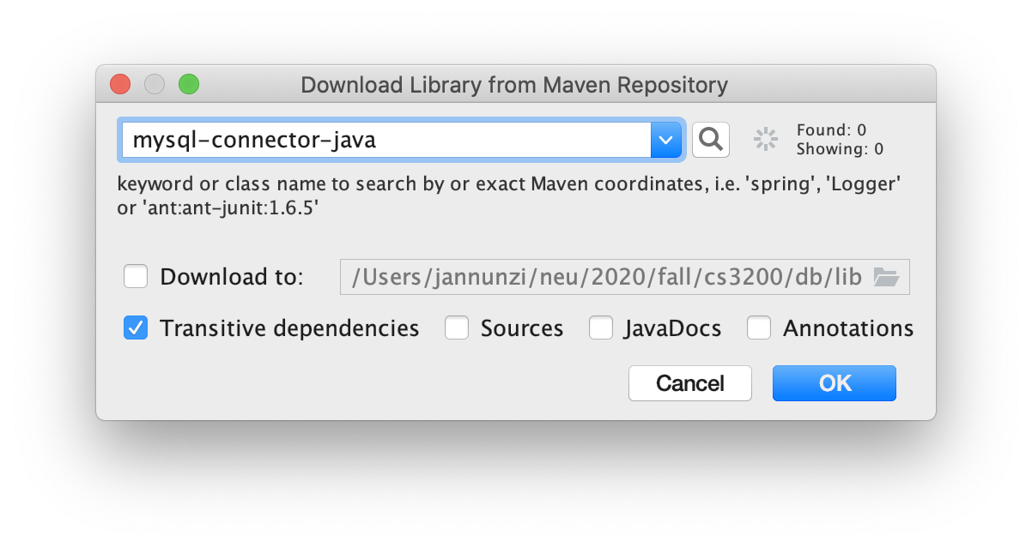
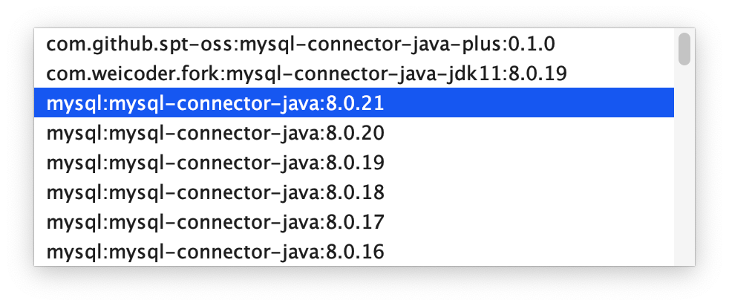
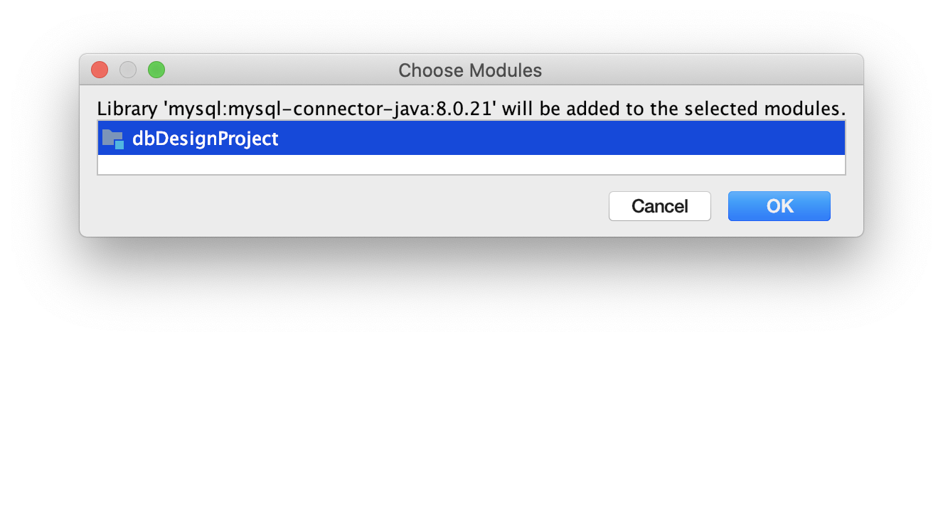
Search for MySQL in Maven Repository
Maven is a repository of libraries we can search and download
Search for mysql-connector-java
Select the latest version
Click on OK to download to your local lib directory

Slide 24
QUERY DB WITH JDBC

Slide 25
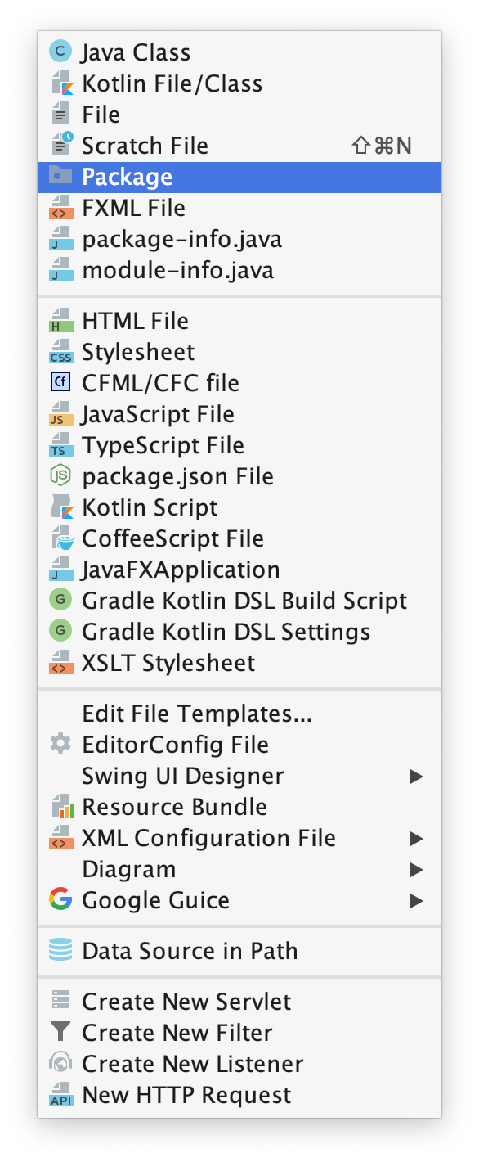
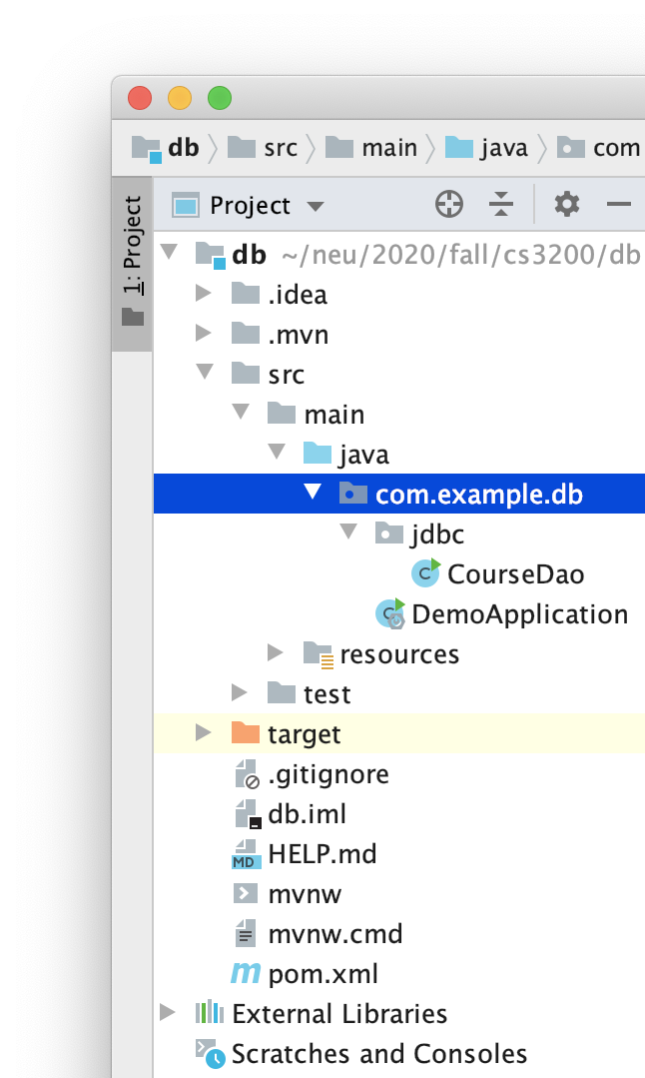
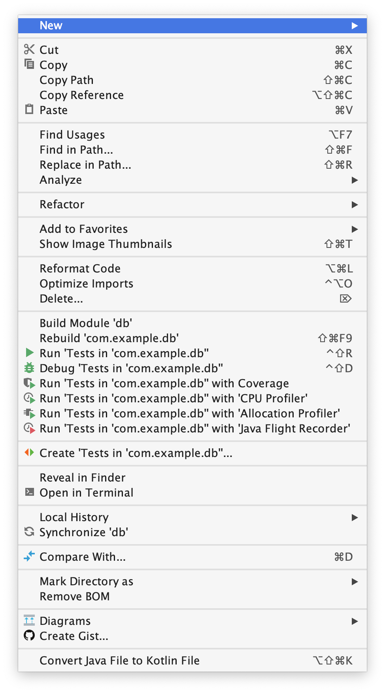
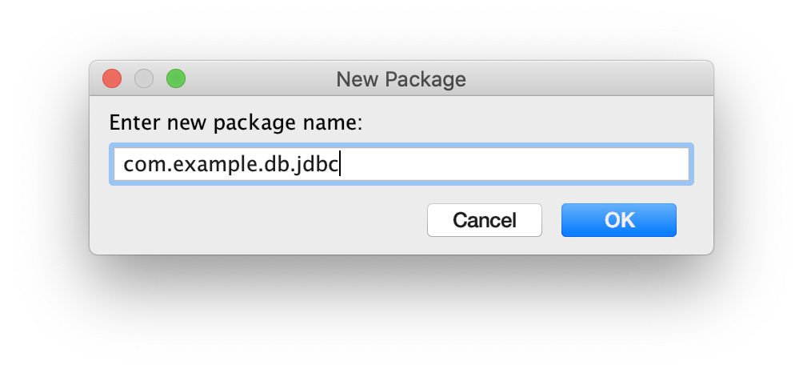
Create a Package
Find the main class DemoApplication under src/main/java
Do your work under the same package as the main class
Let's create a package to experiment with JDBC

Slide 26
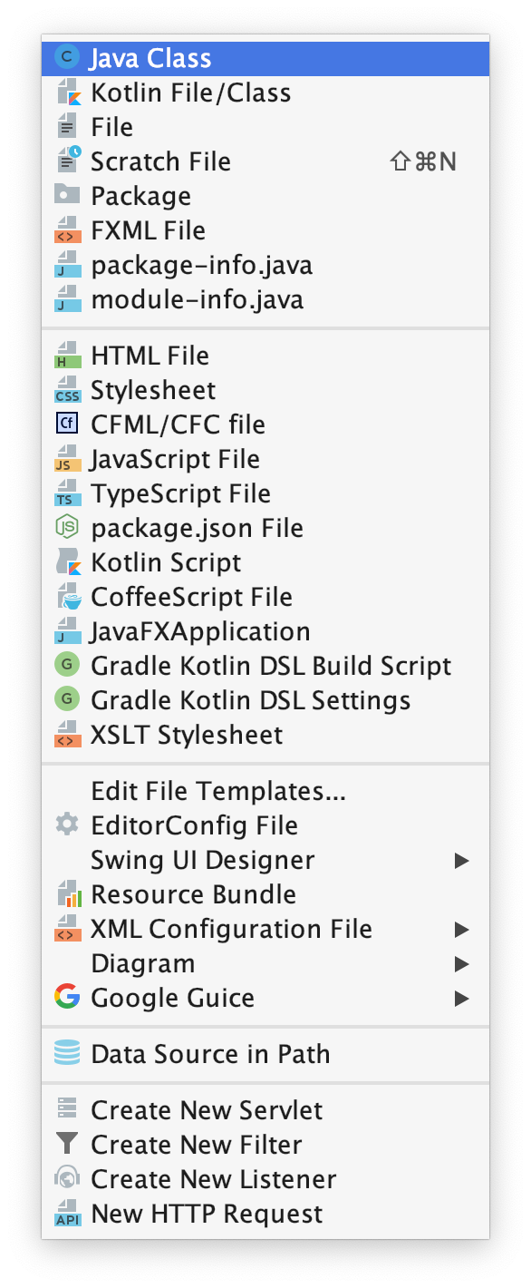
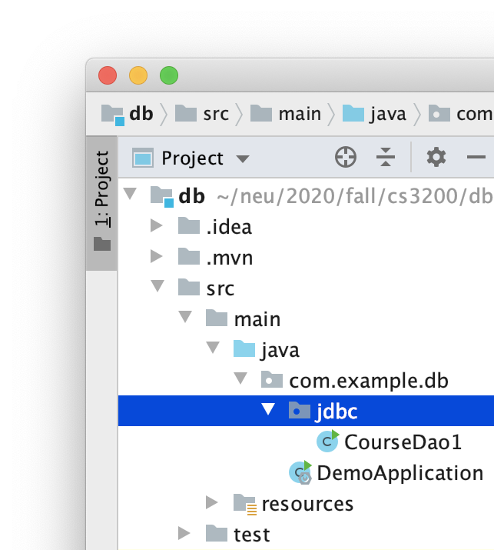
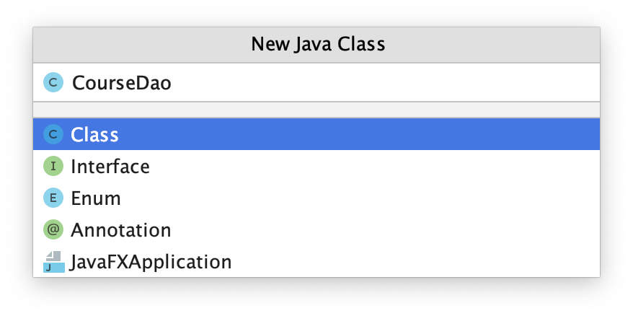
Create a DAO Class
DAOs (Data Access Objects) is a design pattern
Encourages encapsulating accessing data from specific classes
Common to create a DAO per table, e.g., CourseDao

Slide 27
CourseDao
Let's implement the DAO in a main Java class
package com.example.db.jdbc;
import java.sql.*;
public class CourseDao {
public static void main(String[] args) {
}
}

Slide 28
Configuration Strings
Declare configuration strings
public class CourseDao {
static final String JDBC_DRIVER = "com.mysql.cj.jdbc.Driver";
static final String HOST = "localhost:3306";
static final String SCHEMA = "db_design";
static final String CONFIG = "serverTimezone=UTC";
static final String DB_URL =
"jdbc:mysql://"+HOST+"/"+SCHEMA+"?"+CONFIG;
static final String USER = "dbDesign";
static final String PASS = "dbDesign";
}

Slide 29
Declare JDBC Variables
JDBC Connection objects represent live network connections to the database server
Statement objects represent SQL statements
public static void main(String[] args) {
Connection connection = null;
Statement statement = null;
...
}

Slide 30
Load a JDBC Driver
Load JDBC drivers at run time searching the CLASSPATH
MySQL Connector adds a driver class in the CLASSPATH
try {
Class.forName(JDBC_DRIVER);
...
} catch (ClassNotFoundException) {
e.printStackTrace();
}

Slide 31
Connect to Database
Loaded driver is dynamically linked to DriverManager
Use manager to connect to the database
try {
Class.forName(JDBC_DRIVER);
connection =
DriverManager.getConnection(DB_URL,USER,PASS);
...
} catch (ClassNotFoundException) {
e.printStackTrace();
}

Slide 32
Statements Represent SQL
Create Statement from the Connection
try {
Class.forName(JDBC_DRIVER);
connection = ...
String query = "SELECT * FROM courses;";
statement = connection.createStatement();
ResultSet resultSet =
statement.executeQuery(query);
… } catch (ClassNotFoundException | SQLException e) { ...

Slide 33
Iterate Over Records with ResulSet
Statement's executeQuery() sends command to database and returns collection of records as a ResultSet
Iterate over records with ResultSet.next()
ResultSet resultSet =
statement.executeQuery("SELECT * FROM courses;");
while(resultSet.next()) {
String title = resultSet.getString("title");
System.out.println(title);
}

Slide 34
MODELS

Slide 35
Models
Our goal is to map records in the database to object instances in a program
Models can represent records in database
package com.example.db.jdbc.models;
public class Course {
private Integer id;
private String title; }
Match object schema to relational schema

Slide 36
Implement Setters and Getters
package com.example.db.jdbc.models;
public class Course {
private Integer id;
private String title;
public Integer getId() { return id; }
public void setId(Integer id) { this.id = id; }
public String getTitle() { return title; }
public void setTitle(String title) { this.title = title; }
}
Fields are commonly private so declare setters and getters to mutate

Slide 37
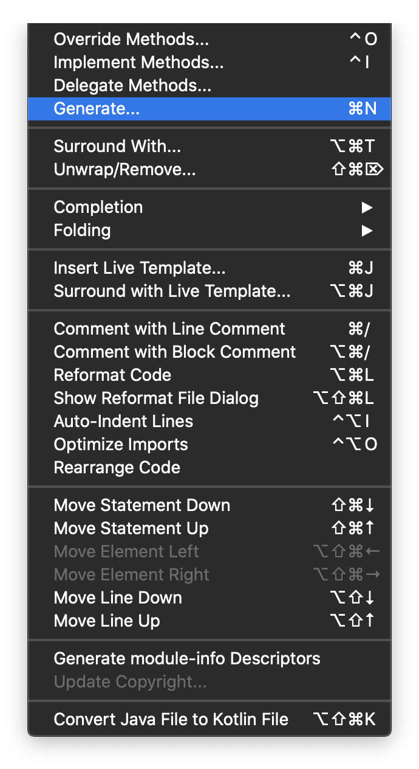
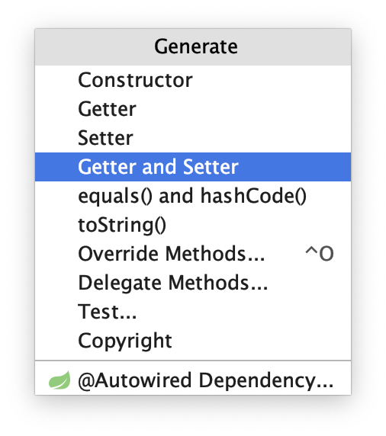
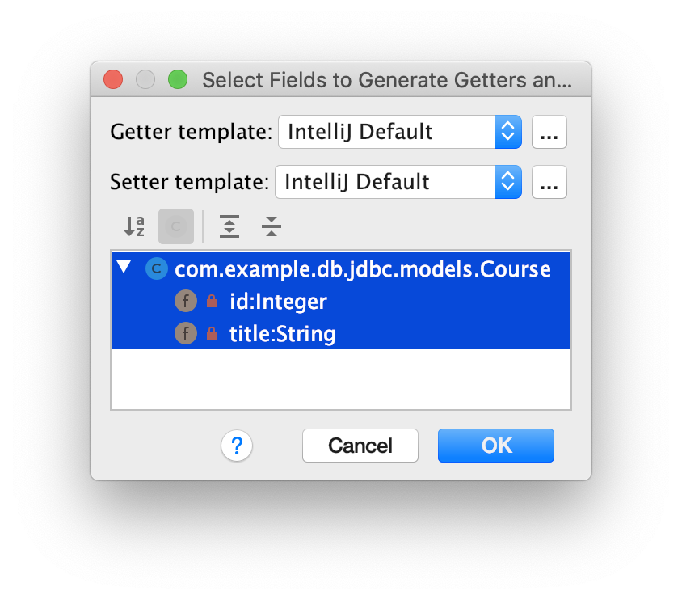
Generating Setters and Getters
Instead of writing setters and getters from scratch, IntelliJ can generate them for you
From the Code menu, select
Generate…
Getter and Setter
Select all fields
OK

Slide 38
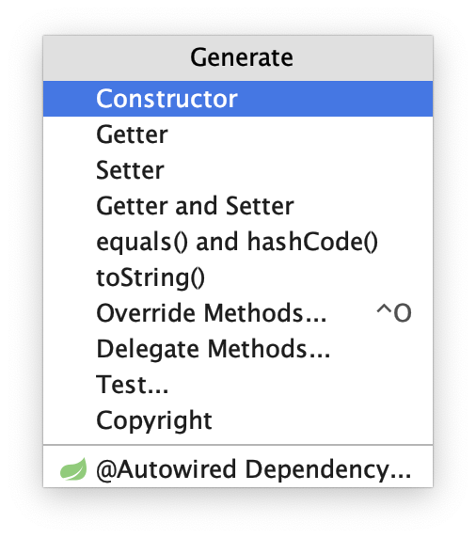
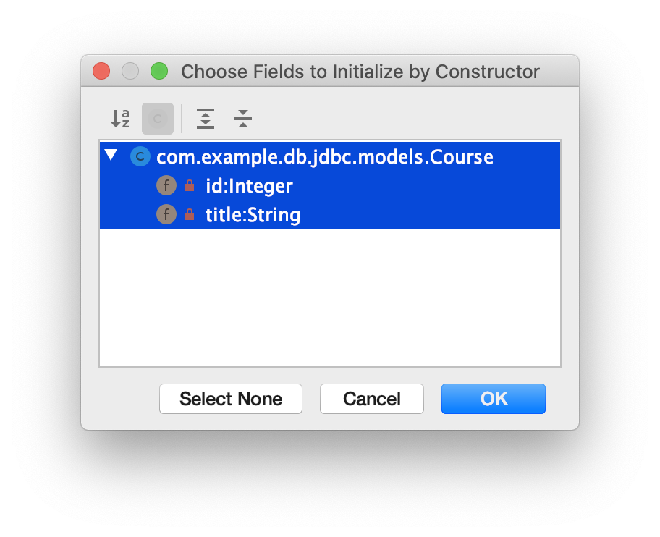
Constructors
It's also a good idea to have all argument constructors
public Course(Integer id, String title) {
this.id = id;
this.title = title;
}
You can also generate constructors from Code → Generate

Slide 39
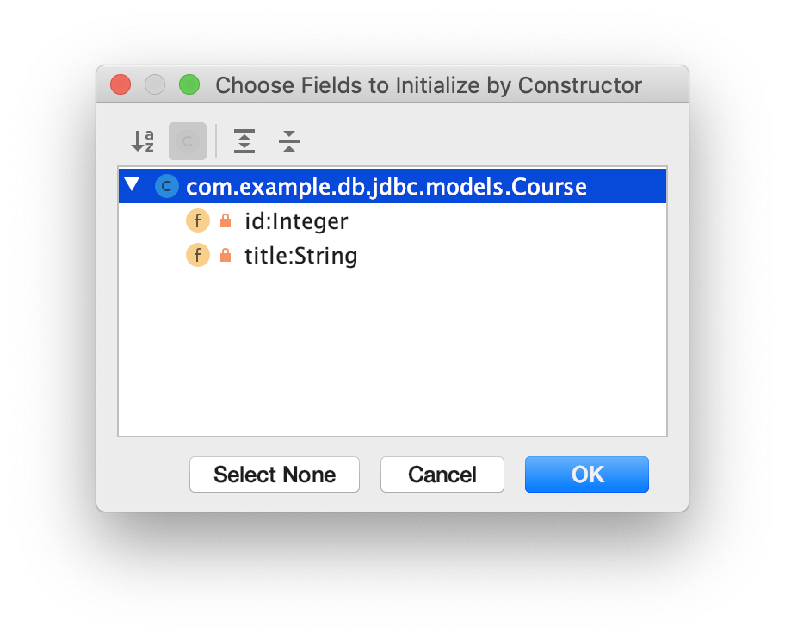
Default Constructors
In Java default constructors (No Arguments) are defined implicitly
But if you declare any other constructor, you must define default constructors explicitly
public Course() { }
Generate default constructors from Code → Generate → Constructor → Select None

Slide 40
toString()
All classes inherit the toString() method to print object instances
For convenience we're going to override the toString() as follows
public String toString() {
return id + ", " + title;
}

Slide 41
DAO API

Slide 42
DAOs Should Implement API to DB
DAO (Data Access Object) is a popular design pattern to encapsulate data access in a class
Common DAO methods implement CRUD operations
List<SQLTable> findAll<SQLTable>()
<SQLTable> find<SQLTable>ById(ID)
<SQLTable> create<SQLTable>(Object)
<Status> update<SQLTable>(ID, Object)
<Status> delete<SQLTable>(ID)

Slide 43
CourseDao.java
In the case of CourseDao, working with records in table courses, we would have the following methods
List<Course> findAllCourses()
Course findCourseById(Integer id)
Course createCourse(Course course)
Integer updateCourse(Integer id, Course course)
Integer deleteCourse(Integer id)

Slide 44
Implementing findAllCourses()
Let's implement findAllCourses() to retrieve all course records
static final String FIND_ALL_COURSES = "SELECT * FROM courses";
public List<Course> findAllCourses() {
Connection connection = null;
Statement statement = null;
List<Course> courses = new ArrayList<Course>();
...
return courses;
}

Slide 45
Connect to the Database
First connect to the database and get a statement object
try {
Class.forName(JDBC_DRIVER);
connection = DriverManager .getConnection(DB_URL,USER,PASS);
statement = connection.createStatement();
...
} catch (ClassNotFoundException | SQLException e) {
e.printStackTrace();
}

Slide 46
Copy Records into Memory
Copy records into Course instances into list of courses
ResultSet resultSet = statement
.executeQuery(FIND_ALL_COURSES);
while(resultSet.next()) {
Integer id = resultSet.getInt("id");
String title = resultSet.getString("title");
Course course = new Course(id, title);
courses.add(course);
}

Slide 47
Using findAllCourses()
Here's how we can use findAllCourses()
public static void main(String[] args) {
CourseDao dao = new CourseDao();
List<Course> courses = dao.findAllCourses();
for(Course course:courses) {
System.out.println(course);
}
}

Slide 48
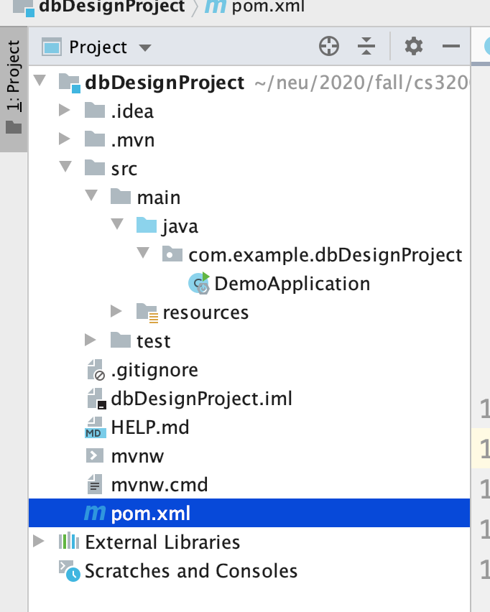
Spring Boot Project Structure
Spring boot applications are Java Maven projects configured through pom.xml files
The entry point of the application is the main class DemoApplication.java

Slide 49
Add JDBC Dependencies
Let's add JDBC database connectivity libraries in the pom.xml, in the <dependencies> section
<dependencies>
...
<dependency>
<groupId>org.springframework.boot</groupId>
<artifactId>spring-boot-starter-data-jdbc</artifactId>
</dependency>
…
</dependencies>

Slide 50
Also Add H2 Database Libraries
H2 is an embedded, in-memory database, needed to connect Spring Boot applications to databases
<dependencies>
…
<dependency>
<groupId>com.h2database</groupId>
<artifactId>h2</artifactId>
<scope>runtime</scope>
</dependency>
…
</dependencies>

Slide 51
Let's Create a Main Class

Slide 52
Create a Spring Boot Project
Spring Boot is a Java framework for easily creating MVC enterprise applications
At a terminal create a new project with the following command
spring init --dependencies=web dbDesignProject

Slide 53
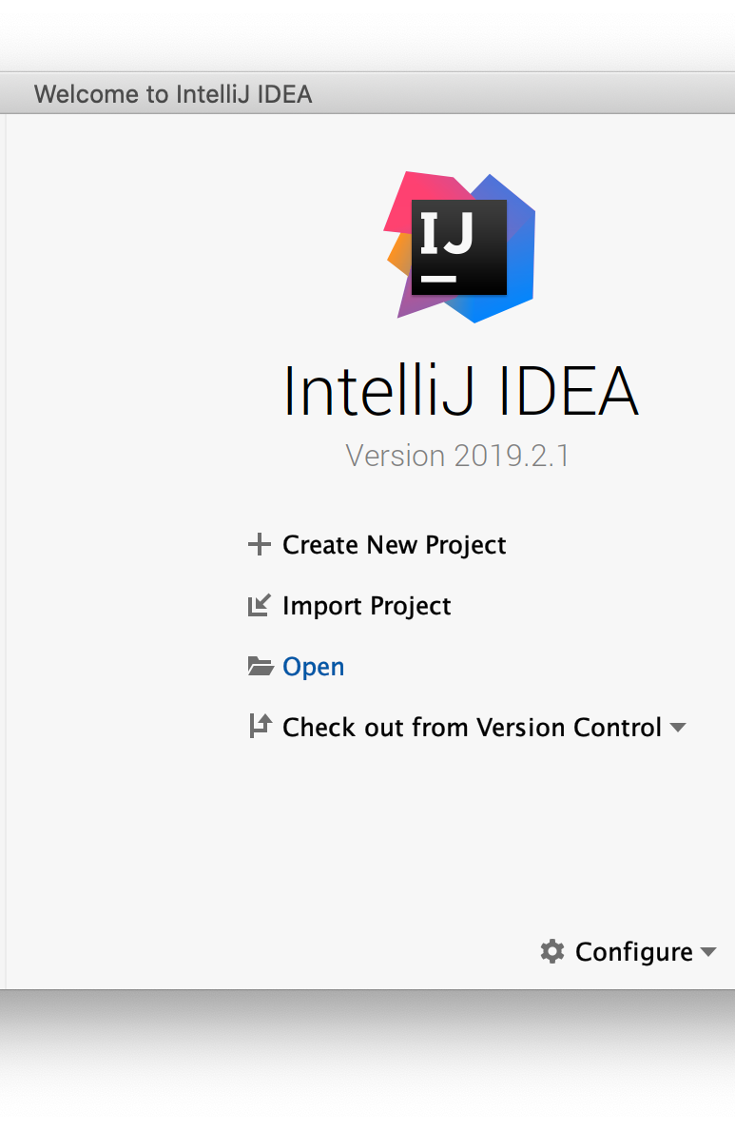
Open Project in an IDE
Spring Boot creates Maven projects
Maven is popular Java package manager for installing libraries, building, testing, packaging applications
Using an IDE, such as IntelliJ, open the project you just created

Slide 54


Slide 55
MIDTERM
REVIEW

